Slide 1
NextHikes IT Solutions
Rossmann Sales Forecasting Using Machine Learning by Harsimran Kaur

Slide 2
Introduction
Rossmann operates thousands of retail stores across Europe and generates large volumes of sales data every day. This project uses historical store information, promotional activities, competition data, and sales records to forecast future store sales using machine learning techniques.
Objectives:
• Analyze historical sales patterns
• Understand factors affecting store sales
• Build a machine learning forecasting model
• Evaluate prediction performance
• Support business decision making through insights

Slide 3
Problem Statement
• Retail sales are influenced by multiple factors such as promotions, holidays, store type, competition, and seasonal trends.
• Accurate sales forecasting is essential for inventory planning, workforce management, marketing campaigns, and business growth.
• Traditional forecasting methods may not capture complex relationships in large datasets.
• Therefore, a machine learning-based forecasting system is developed to predict future sales more effectively.

Slide 4
Project Objectives
• Analyze historical sales data from Rossmann stores.
• Identify factors affecting daily sales performance.
• Perform data cleaning and feature engineering.
• Build and train a Random Forest Regression model.
• Evaluate model performance using MAE, RMSE, and R² Score.
• Generate sales predictions for unseen test data.
• Support business decision-making through data-driven insights.

Slide 5
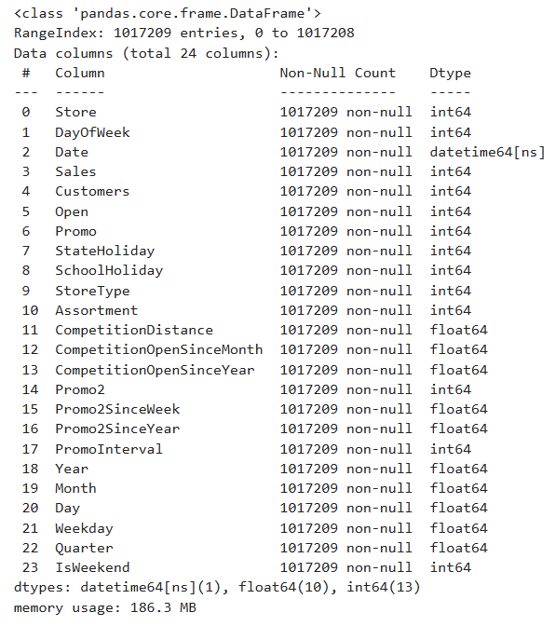
Dataset Overview
The Rossmann Sales Forecasting project uses three datasets:
• Train Dataset
• Historical sales records
• Contains target variable: Sales
• Test Dataset:
• Future store records
• Used for generating predictions
• Store Dataset:
• Store information
• Store type and assortment
• Competition details
• Promotion information

Slide 6
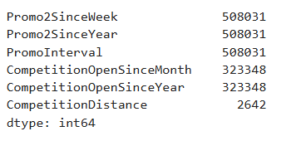
Data Preprocessing
Data preprocessing was performed to prepare the dataset for machine learning.
Key Steps:
• Merged train and store datasets.
• Handled missing values in competition and promotion-related columns.
• Filled numerical missing values using median values.
• Filled categorical missing values with default values.
• Removed inconsistencies and prepared clean data.
• Generated a complete dataset for feature engineering.

Slide 7
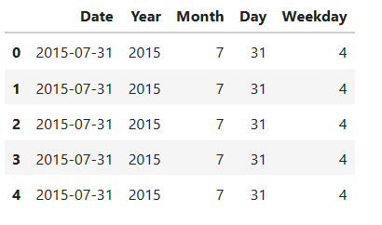
Feature Engineering
Feature engineering was performed to extract useful information from the Date column.
New Features Created:
• Year
Captures yearly sales trends.
• Month
Helps identify seasonal patterns.
Day
Represents daily sales variations.
• Weekday
Captures weekly customer behavior.
Benefits:
• Improves model learning.
• Enhances prediction accuracy.
• Helps identify temporal sales patterns.

Slide 8
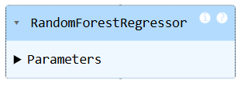
Model Building
A Random Forest Regression model was selected for sales forecasting.
Reasons for selecting Random Forest:
• Handles large datasets efficiently.
• Captures complex relationships between features.
• Reduces overfitting through ensemble learning.
• Provides feature importance analysis.
• Delivers robust prediction performance.

Slide 9

Model Evaluation
The Random Forest Regression model was evaluated using standard regression metrics to measure prediction accuracy and reliability.
Evaluation Metrics:
• Mean Absolute Error (MAE)
• Measures average prediction error.
• Root Mean Squared Error (RMSE)
• Penalizes larger prediction errors.
• R² Score
• Indicates how well the model explains sales variations.
• These metrics help assess overall model performance and forecasting capability.

Slide 10
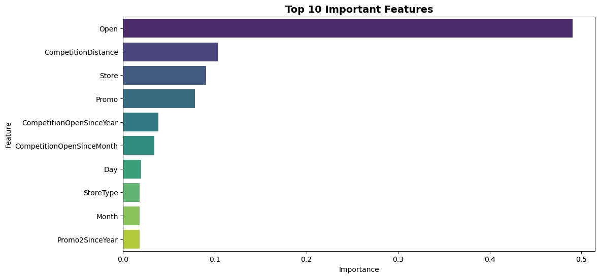
Feature Importance Analysis
🟢 Open stores contribute most to sales.
🔵 Promotions strongly influence revenue.
🟠 Competition impacts store performance.

Slide 11
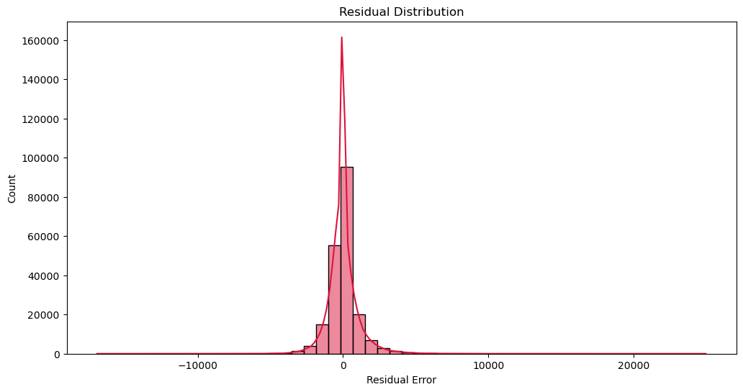
Residual Analysis
🟢 Most residuals are centred around zero.
🔵 Prediction errors are relatively small and balanced.
🟠 The model shows good generalization performance.

Slide 12

Model Deployment & Prediction Generation
The trained Random Forest model was used to generate predictions on unseen test data.
• Prediction results were exported to a CSV file.
• The saved model can be reused without retraining.

Slide 13
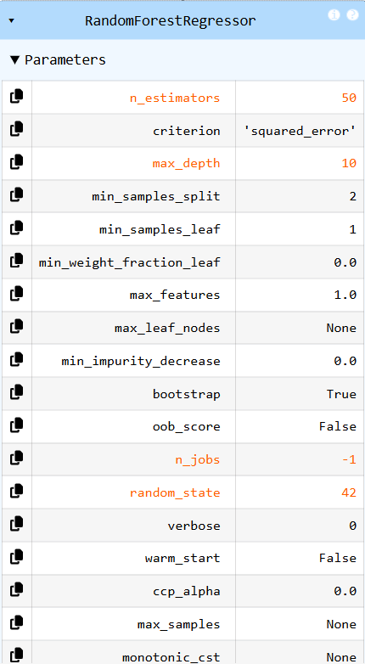
Model Optimization & Compression
• To improve deployment efficiency, a smaller Random Forest model was created.
• The optimized model used fewer trees and a limited depth to reduce complexity.
• Model compression was applied using Joblib serialization.
• The optimized model requires less storage while maintaining good performance.

Slide 14
Business Impact & Benefits
• Accurate sales forecasting helps stores maintain optimal inventory levels.
• Forecast predictions support workforce and staffing planning.
• Promotional campaigns can be planned more effectively using forecasted demand.
• Data-driven insights help managers make informed business decisions.
• Improved forecasting reduces operational costs and business risks.

Slide 15
Interactive Dashboard
An interactive dashboard was developed using Streamlit to visualize sales performance and forecasting insights.
• Dashboard Features:
• KPI Cards for key business metrics
• Interactive filters for data exploration
• Monthly sales trend analysis
• Store performance visualization
• Competition impact analysis
• Correlation heatmap

Slide 16
Interactive Dashboard
Built a Streamlit dashboard with KPIs, filters, charts, heatmaps, and business insights.

Slide 17
Business Recommendations
Improve promotional planning, focus on high-performing stores, and use data-driven strategies.

Slide 18
Conclusion & Future Scope
Forecasting model delivered actionable insights. Future work may include deep learning and real-time forecasting.

